Slide 1

Bee Tagged Contact. Search.
Notes:
Audience: Investors and potential users. Logo for credibility that it’s real. Simple tag line and a lot of focus on the company without much info. Font is Avant Garde to keep content with sans serif and modern. The point of the deck is to support that BeeTagged is worthy of investment. The next few slides explain that there is pervasive pain in how we search our networks for information (Claim) and then I go to address how BeeTagged will resolve those pains (Data) and then show that the product and team and money opportunity are the right way to address this, so invest in us (Warrant). Color scheme is consistent. Blue is and honey-orange are the colors of the deck. Colors: Blue communicates professional and trust (like LinkedIn), and honey-orange for excitement and opportunity. Also, template has soft professional colors and hoops, which can represent the app’s interconnectivity. Animation for Bee buzzing is to add subtle humor but also remind people subconsciously that the bee represents a builder who travels from one flower to another collecting and connecting pollen.
Time: Intro 30secs.

Slide 2

Why We Are Here
Bee Tagged is looking for investment partners for a novel way to connect our personal networks in a more powerful way
Notes:
Goal of presentation upfront. Emphasis on keywords: connect, personal, network, power. Photo shows connectivity with an iPhone, professional, personal, and with network nodes. Color is consistent with rest of deck’s professional focus as well.
Time: 30 secs

Slide 3
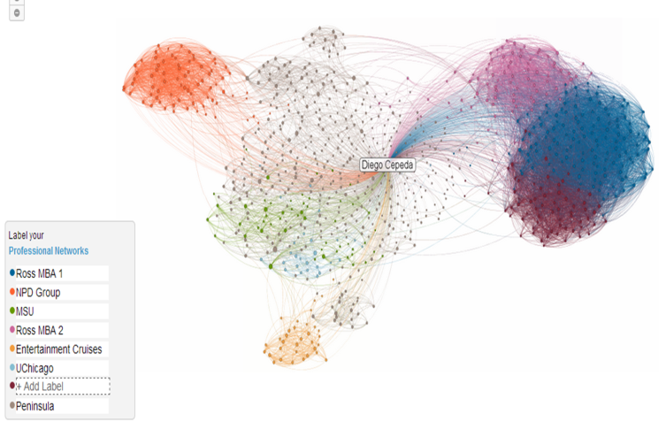
Connection Is Power
“Networking is not about just connecting people. It’s about connecting people with people, people with ideas, and people with opportunities.” ― Michele Jennae, personal business coach
“Fully experiencing the connection that exists between us all is the secret to true contentment.” ― Simon Boylan, personal development specialist
Notes:
Start with common ground story. Story in headlines. Use titles for expertise credibility. Show picture of network for visual representation. Read with some strategic moments of reflection. Emphasize the access and opportunity a product could bring on an emotional level.
Time: 1.5 min

Slide 4




Search Is a Pain
Have you…
Ever thought about someone who does something and not remember his/her name?
Ever wondered who is near you now to join in an activity?
Ever used Facebook, LinkedIn’s, Gmail’s search and not found a contact’s information you needed?
Notes:
Common ground pains. Why do we care? Put a little humor. After these points, the conversation would be a story around why I pursued BeeTagged and my interest in networks.
Time: 2 min

Slide 5
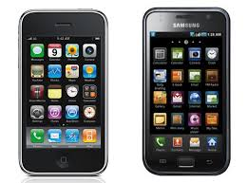

The Pain Is Big and Addressable
% of Productivity and Networking Apps
320M Smartphones
20%
Notes:
Speak to investors (drivers). Use data to highlight opportunity. Data supports why product makes sense. Build the slide for clarity. Leave anticipation for key point. Walk through slowly to emphasize opportunity.
Timing : 2 min

Slide 6

…and Consumers Want to Pay
39%
of Consumers Are Willing to Pay $0.99+ for Bee Tagged*
* From survey of representative US sample n= 114
Notes:
Speak to investors (drivers). Punchline for presentation. Put data on its own slide for more impact. Photo kind of looks like tech-network-money and has action consistent with app usage. Add note at bottom to add credibility.
Timing : 30secs

Slide 7
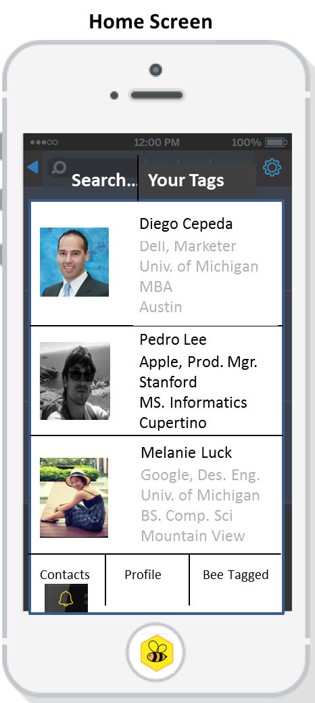
Bee Tagged Disrupts… Gain powerful search of your network with tags
Features | Benefits
Scroll Easily | Fast Search
Search by Tags | Relevant Search
Pulls Facebook Fields | Saves Time and Makes Info Useful
See Contact Detail | More Useful to You
Integrates with Social Media and Google | Brings Life Together
Alerts | Call to Action
Features | Benefits
Scroll Easily | Fast Search
Search by Tags | Relevant Search
Pulls Facebook Fields | Saves Time and Makes Info Useful
See Contact Detail | More Useful to You
Integrates with Social Media and Google | Brings Life Together
Alerts | Call to Action
Features | Benefits
Scroll Easily | Fast Search
Search by Tags | Relevant Search
Pulls Facebook Fields | Saves Time and Makes Info Useful
See Contact Detail | More Useful to You
Integrates with Social Media and Google | Brings Life Together
Alerts | Call to Action
Features | Benefits
Scroll Easily | Fast Search
Search by Tags | Relevant Search
Pulls Facebook Fields | Saves Time and Makes Info Useful
See Contact Detail | More Useful to You
Integrates with Social Media and Google | Brings Life Together
Alerts | Call to Action
Features | Benefits
Scroll Easily | Fast Search
Search by Tags | Relevant Search
Pulls Facebook Fields | Saves Time and Makes Info Useful
See Contact Detail | More Useful to You
Integrates with Social Media and Google | Brings Life Together
Alerts | Call to Action
Features | Benefits
Scroll Easily | Fast Search
Search by Tags | Relevant Search
Pulls Facebook Fields | Saves Time and Makes Info Useful
See Contact Detail | More Useful to You
Integrates with Social Media and Google | Brings Life Together
Alerts | Call to Action
Features | Benefits
Scroll Easily | Fast Search
Search by Tags | Relevant Search
Pulls Facebook Fields | Saves Time and Makes Info Useful
See Contact Detail | More Useful to You
Integrates with Social Media and Google | Brings Life Together
Alerts | Call to Action
Notes:
Speak to investors about benefits. Use visuals for credibility and expertise. Table organizes information. Lot of info, but nice to see benefits alongside features. Build is supposed to organize data in digestible way. Sentence at top emphasizes biggest benefits.
Time: 2.5min

Slide 8
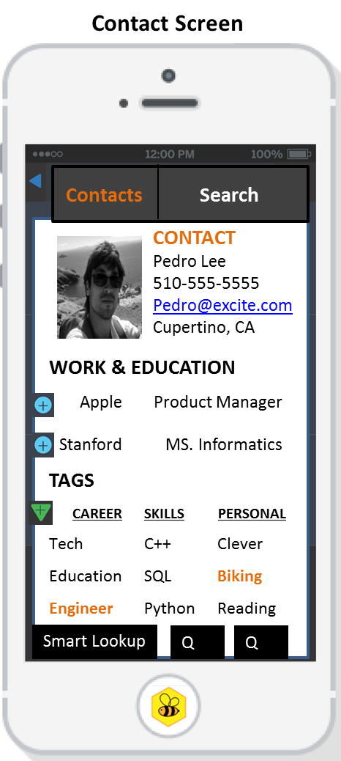
Bee Tagged Customizes to You
Personalize tags of how YOU see YOUR world
Search YOUR world as YOU define it
Keep up-to-date with the people that matter to YOU
Have the freedom to privately tag anyone in YOUR social or professional networks
Notes:
Put important info upfront in bullet form. Picture on right should be focus for this slide; highlights more product features. Use bold to highlight You. Blue to highlight key benefits and value proposition.
Time: 2min

Slide 9
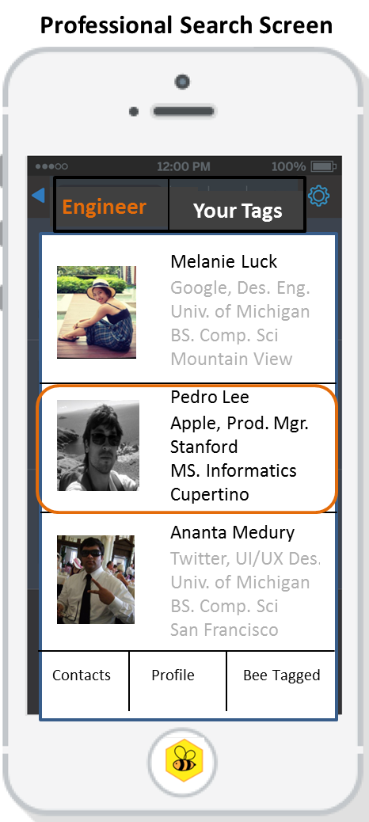
Bee Tagged Can Monetize
Download for $0.99 to gain functionality
Target users with advertised jobs, products, and services
Sell market research insights
Notes:
What the investors want to see. Text on right is focus. Use #s to emphasize 3 strategies. Rotate different shots of product left and right to put focal points on right, where the eyes go.
Time: 1min

Slide 10
Users Drive Growth
*Initial costs are boot-strapped
Notes:
Success! Will talk about cost structure since investors will want to know what the $100K is for. Initial costs are $0 because of boot strap (employees can afford no wages while working and at school). Will need money to invest in servers, rent, and 5 employees (1 developer, 1 statistician, and 1 marketer, me and partner). Average salary will be about $100K to attract top talent. Each year after the company will double in staff. Spend time explaining since investors want to know operations.
Time: 2min

Slide 11
A Great Team Brings Users
CEO
MBA
Marketer
Networker
Digital Fan
Entrepreneur
Bee Tagged
CTO
Computer Science
Engineer
Mastermind
Digital Creator
App Developer
Diego Cepeda
Dom Parise
Notes:
Mention team for credibility. Keep it simple and parallel. Photos and logo carry same weight. Blue highlight for trust.
Time: 1 min

Slide 12

Users and Money Attract Buyers
Social Media
Phone
Search
Service Provider
Notes:
Template for clarity. Also syncs well with Bee Tagged’s honeycomb. Our logo is squeezing its way into the demand. Key companies and icons for impact and symbolism for industries we will target for exit.
Time: 1min

Slide 13

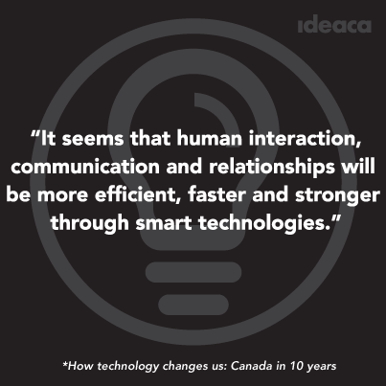

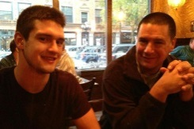

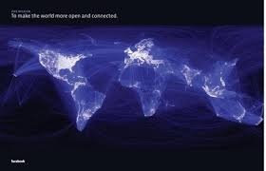
$100K Investment Builds Dreams
$100K
Notes:
Simple picture representing what the $100K will build and a quote to tie back to the beginning. The image is built alongside. Start with reading quote to tie everything together and then show build of team that builds the infrastructure and technology that ultimately connects the world at a fast, buzzy rate.
Time: 2min

Slide 14

ANSWERS
Notes:
Boardroom style deck. Some humor instead of questions. Man in corporate colors with magnifying glass “searching” for answers. It’s what Bee Tagged does.
Remainder of time to accommodate interruptions and questions.

Slide 15
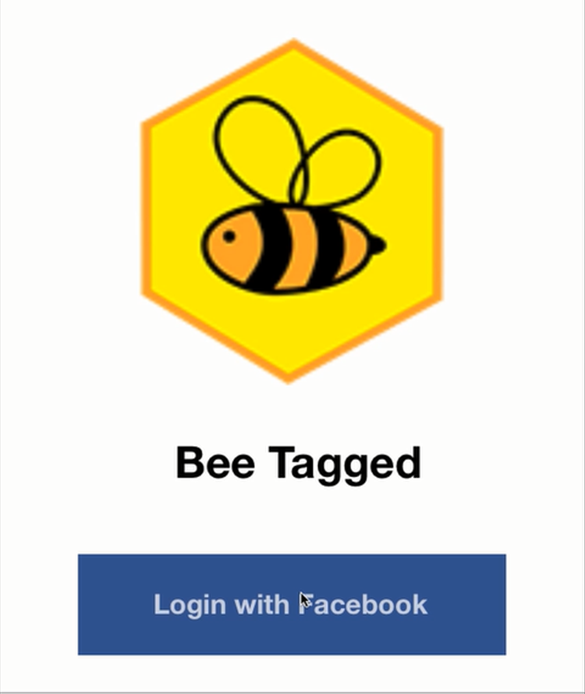
Login

Slide 16
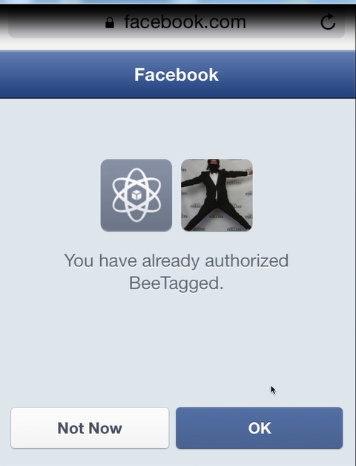
Facebook login

Slide 17
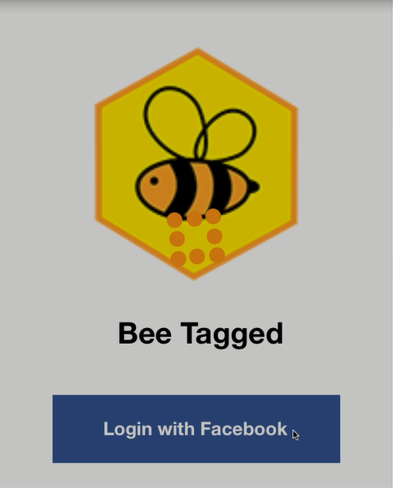
Facebook loading
Notes:
Keeps going until all contacts loaded.

Slide 25
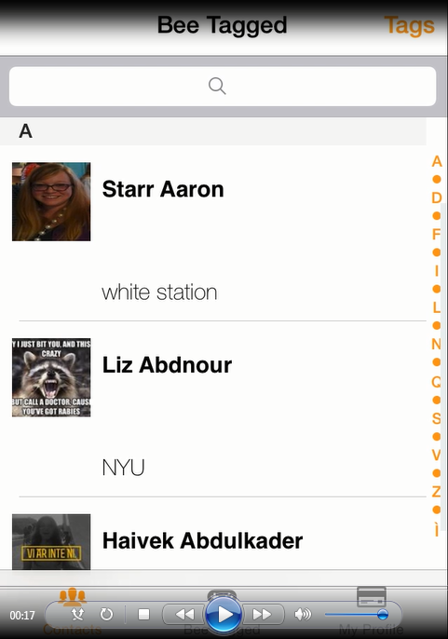
Home Screen
Notes:
White Station capitalization; white space; cut off profile, scroll to top with click on BeeTagged

Slide 26
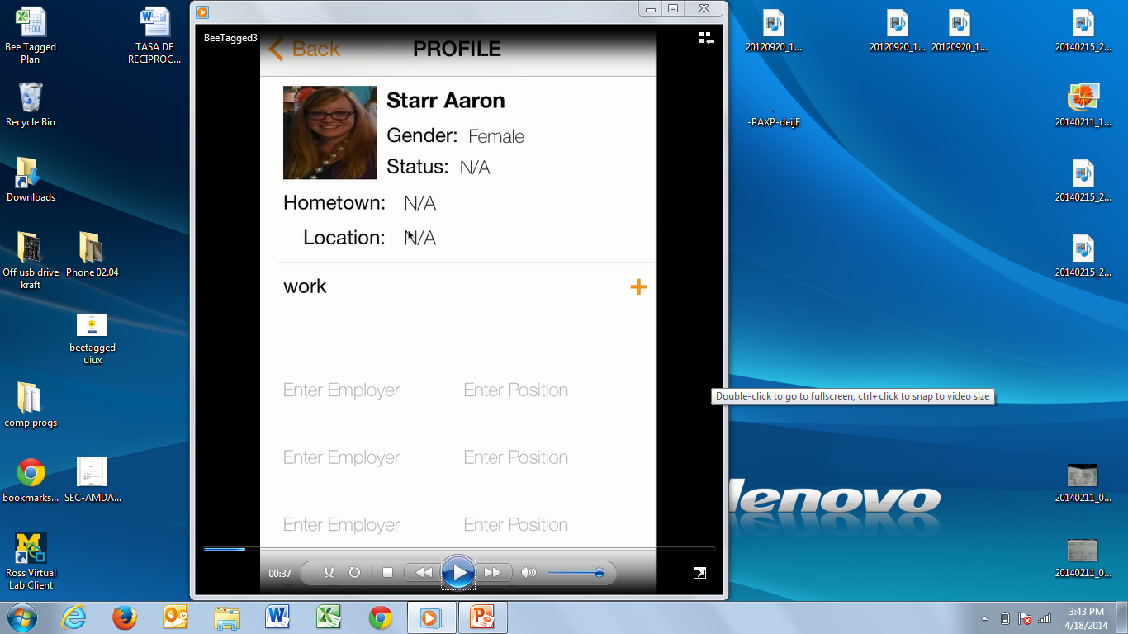
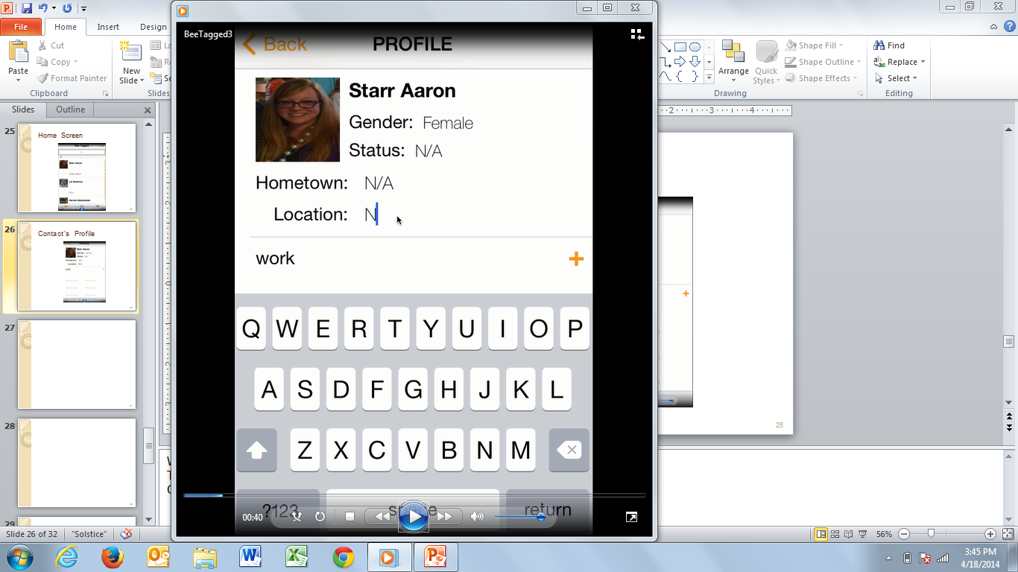
Contact’s Profile
Notes:
Want to edit location and save; edit mode
Too many work fields without work details in any of them
Capitalization of work
Can’t exit keyboard on right screen when editing location. “Return” button should work. Should have option of clicking on another field to leave location.
Edit Status and Hometown?!
GPS lookup of Location?!
Can drag down screen, but there is no function associated with that (no usefulness in seeing or interacting with more on the screen)

Slide 27
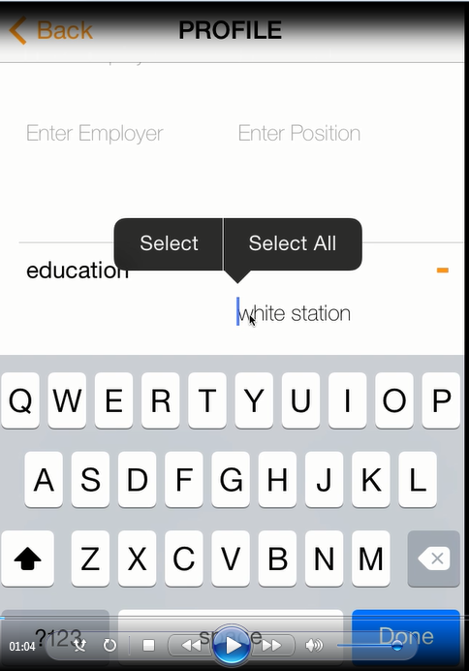
Contact’s Profile Education Field
Notes:
What are select/select all functions?
Education should be capitalized
See entry issues with work
Capitalization default for names?
Auto lookup eventually? (Anything predictive based on hometown or other field info?)

Slide 28
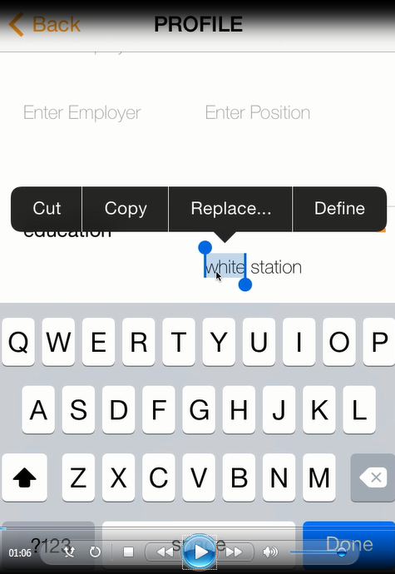
Contact’s Profile Education Field
Notes:
What is cut/copy/replace/define there for? In editing can’t just manually click on letter and edit.

Slide 29
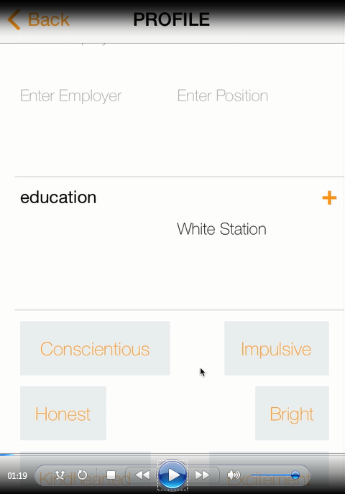
Tags Screen
Notes:
Screen at top should show “work” or at least a completed field (all info present on screen should be useful info)
Space between honest and bright
What is logic of order of words
Can we color tags by certain categories (i.e work, fun, personality, etc).
Have a select color function

Slide 30
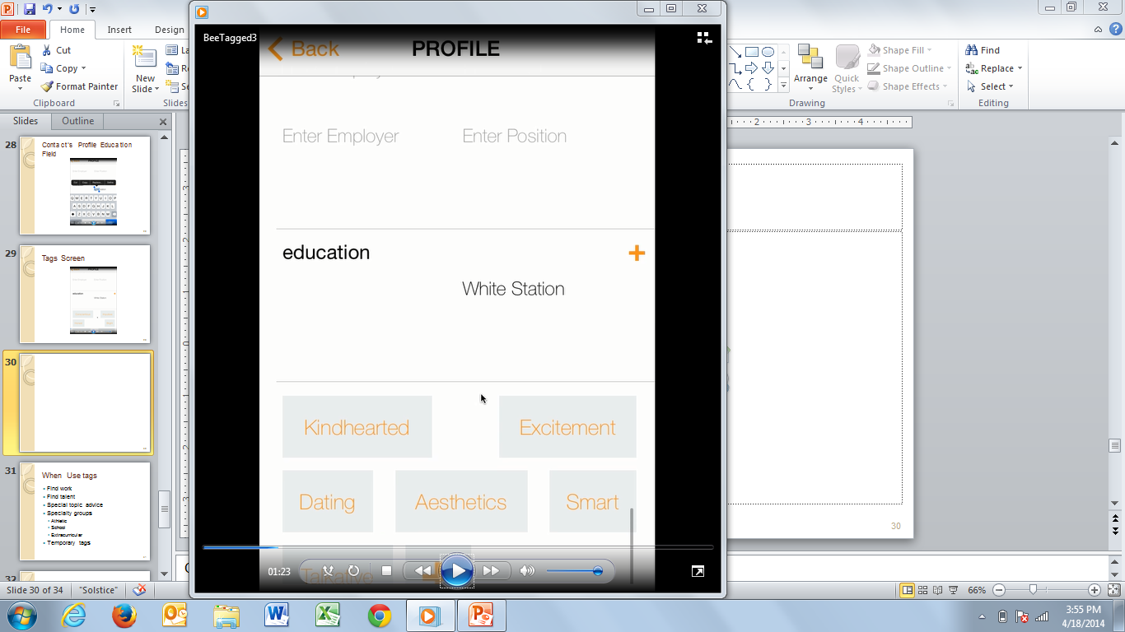
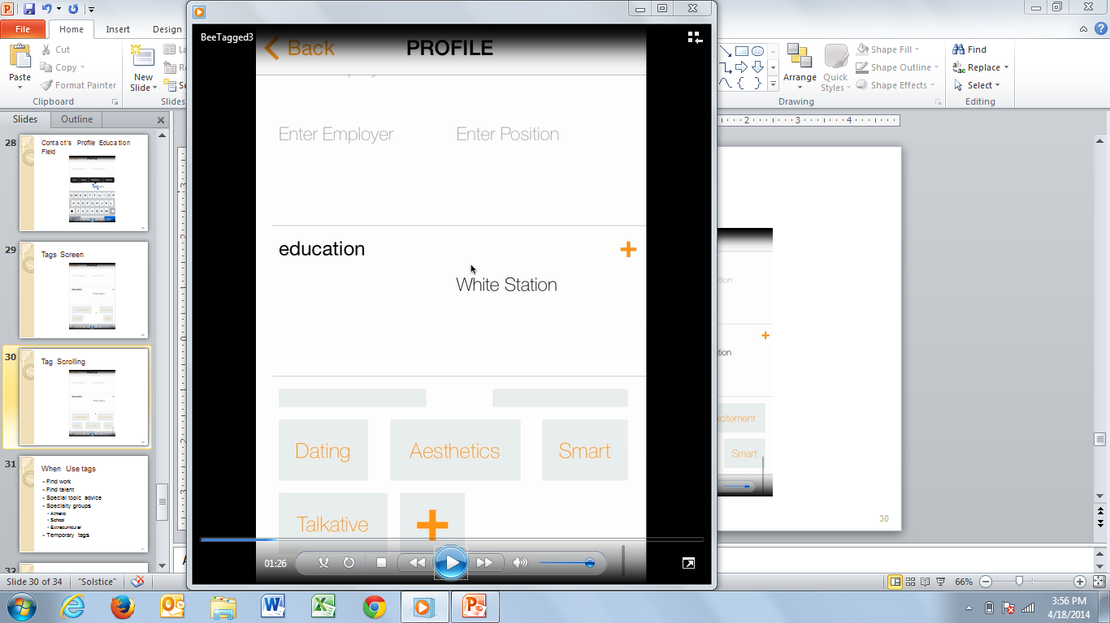
Tag Scrolling
Notes:
As you scroll down with finger, not seamless. Should be able to manually move tags around.
On right, can only see bottom by holding screen clicked all the way at the top (look at finger-mouse click location)

Slide 31
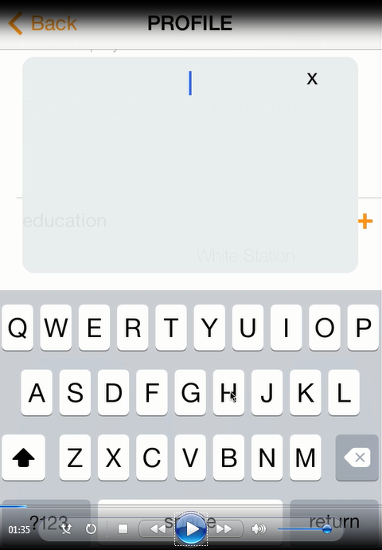
Add Tags

Slide 32
When Use tags
Find work
Find talent
Special topic advice
Specialty groups
Athletic
School
Extracurricular
Temporary tags
Notes:
Tag use vs. group function – keep separate
Business vs. Fun

Slide 33
Why Tag
Communicate
Coordinate
Organize
Subjective vs. Objective Tags

Slide 34
What Else is Tagged
Endorse
“Likes”
Tag
Symbol
Newsfeed
Search
Bucket
Zagat Stars
Notes:
Symbol of what someone represents
Facebook Likes
LinkedIn Endorsements
Search terms
Newsfeeds
Ranks and Stars

Slide 35
Gamification- Entertainment
Hot or Not
150 people for the wedding
BFF Tags
Tinder Tags (you have a match)
Cascading news of Tags
Bring in news related to Tags
Swipe into categories and get rewards/badges
Add companies
Trivia

Slide 36
Concept Test

Slide 37
Bee Tagged

Slide 38
Bee Tagged Contact. Search.
What Does Bee Tagged DO?
App to Find, Sort, & Group your contacts.
Personalized tags of how YOU see YOUR world
Search YOUR world as you define it
Stay updated with contacts that matter to YOU
Solves Need to Easily Sort & Search Contact List:
Improves Social & Professional Networking
Notes:
Your contacts are everywhere: social media, on your phone, in your email contacts. This makes it tough to search for them if you want to message them or find people in a particular group or location

Slide 39
Development Process & Ideation
Separation in scale:
- Expand users’ networks through Facebook
Separation in condition:
- Users can update social media profiles dynamically and keep privacy
- Users’ exclusive right to share information or tags to public
Our Areas of Impact
 | Past | Present | Future
Super System | Calendars to auto sync or organize contacts | Mobile platform, internet, and smartphone | Interchangeable tagged info when switching phone platform
System | Memorize contact name | Searching/grouping contacts | App to organize
Sub System | Favorites, organizing contacts by most used | Mobile application (Facebook, Linkedin), users, friends/families in user’s networks | Auto Group, Auto Update

Slide 40

Economic Value to Customer
Reference value:
Differentiation value:
Features | Benefits
Scroll Easily | Fast Search
Search by Tags | Relevant Search
Pulls Facebook Fields | Saves Time and Makes Info Useful
See Contact Detail | More Useful to You
Integrates with Social Media and Google | Brings Life Together
Alerts | Call to Action
Time: Find Contact Information | Average Hourly Wage For Target Customer | Value of Time Wasted
5 | $36.72 | $3.06
Using App Saves Time & Money
Notes:
Last line is a segue for finding out that people would buy / download
The customer will only use this app if its value outweighs the value of the closest alternative.
Reference value of the current competition includes features built in to Facebook, LinkedIn, GroupMe, and Google. Each has some functionality with limitations.
Differentiation value: Bee Tagged disrupts the address book and integrates data from social networks.

Slide 41
Focus Group & Concept Test Results
Focus Group
Some people like ‘social’ Bee Tagged, others like ‘professional’
Privacy is an important component of app usage
Juggling social media and address books is confusing
Concept Test
Will Users Pay: 39%
Is App Useful: 55%
Is App Unique: 63%
Will App Improve Networking: 50%
App Appeals To Customers: Two Segments Emerging
Notes:
Re-title: Research: Focus Group and Concept Test Results
Change key take away on bottom
Put focus group professional take aways
Started with hypothesis, innovated, took

Slide 42
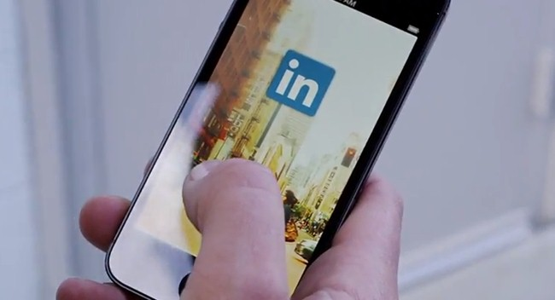

Market Research & Trial
Notes:
Market Research provided a top box estimate of Triability
Market Segmentation strong with Men, > 100 Facebook Friends, Regular Users of Linked (>300 contacts). Survey sample concentrated on those ages 22 < X < 35. That is accurate those are users who own smartphones and are active on Social Networks

Slide 43

Business Model & Revenue Potential
Consider Tiered Downloads $0.99 - $1.99
Upsell & Add-on Potential
DSIR Network effects
% of Productivity and Networking Apps
% Willing to Pay $0.99+ for the App
123M LinkedIn + Facebook Users
20%
Revenues Dependent on Innovation & Increased Features

Slide 44
Summary & Next Steps
Summary
Current pain points could be alleviated with Bee Tagged features.
Potential users find features useful for social and professional purposes.
Trial rates would generate a solid user base and a sustainable business model.
Next Steps
Research
Conduct usability testing
Explore other segments (non-MBAs) and preferred app features
Marketing
Focus value proposition to one key feature
Test positioning differences between networking and social
Product
5. Optimize key features
Notes:
After concept test, it’s unclear what the different consumer segments value most. One groups likes social, one for professional. Therefore, picking the right group to start is very important.

Slide 45
Appendix 1: Survey Summary

Slide 46
Appendix 2: Survey Summary Two

Slide 47
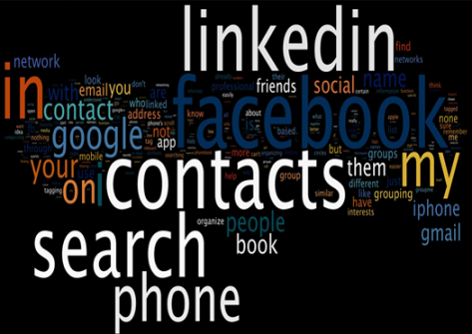
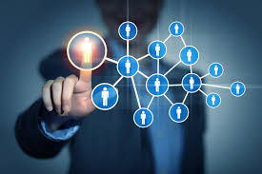
APPENDIX: Product Category
Customers Associate Bee Tagged with Productivity

Slide 48
Concept Test Results

Slide 49
Bee Tagged
Contact search at your fingertips.
Bee Tagged allows users to tag their networks in a personal way that only the user can see on his/her Smartphone. Users can synchronize tags from various Facebook fields and create or delete their own custom tags (similar to “endorsements”). Tagging enables users to search their address book and Facebook connections based on tagged attributes. Bee Tagged’s key features are searching and then grouping multi-attributes for example: coordinating a nearby activity with a group of friends. Bee Tagged is a search tool for the network that travels in your pocket (available for Android and iOS).
Bee Tagged sources a baseline of tags based on Facebook’s fields, which include: university, degree, company, function, hobbies, activities, languages, and “likes”. The user’s privacy settings in Facebook are preserved exactly in the same manner in Bee Tagged, and no other person can see how users tag their networks. Once a user registers through Facebook, then any subsequent updates to fields in Bee Tagged will be synchronized with Bee Tagged’s server. This synchronization backs up all the user’s phone contacts that the user can download to any phone.

Slide 50
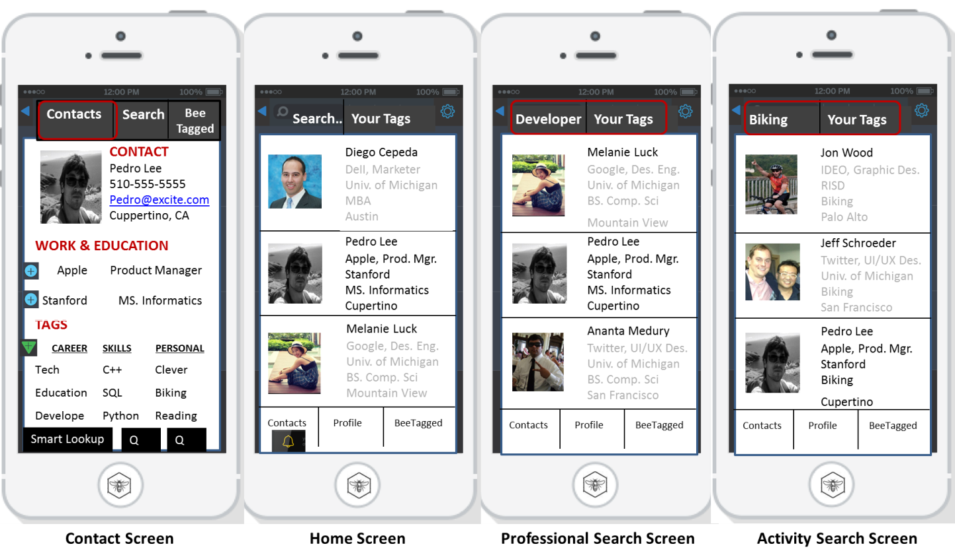
Above: Contact (left): can edit contact information, work, education, tags, and custom tags. Home (center): Address book, contact with summary and drop down details, search, and access to other screens. Professional Search (center right) and Activity Search (far right): search for any attribute in contact’s screen, rank by weighted tags, and group.

Slide 51
Would you use Bee Tagged on your phone?
5-Definitely would use
4-Probably would use
3-Might or might not use
2-Probably would not use
1-Definitely would not use
How much would you pay as a ONE-TIME fee to use Bee Tagged?
US$ 0
US$ 0.99
US$ 1.99
From US$ 2 to US$ 4.99
From US$ 5.00 to US$ 9.99
How useful do you think Bee Tagged would be? Please rate on a scale of 1-5
5 - Extremely useful
4 - Very useful
3 - Somewhat useful
2 - Slightly useful
1 - Not useful at all
Overall, how would you rate Bee Tagged’s uniqueness? Please rate on a scale of 1-5
5 - Extremely unique
4 - Very unique
3 - Somewhat unique
2 - Slightly unique
1 - Not unique at all
Based on the description of the product, how relevant is it to your needs? Please rate on a scale of 1-5
5 – Extremely relevant
4 – Very relevant
3 – Somewhat relevant
2 – Lightly relevant
1 – Not relevant at all
How much will the app help you organize/find new social activities? Please rate on a scale of 1-5
5 - Definitely will improve
4 - Will improve
3 - Somewhat improve
2 - Slightly improve
1 - Definitely will not improve
How much will the app help your networking activities? Please rate on a scale of 1-5
5 - Definitely will improve
4 - Will improve
3 - Somewhat improve
2 - Slightly improve
1 - Definitely will not improve
How important are apps that help you improve networking? Please rate on a scale of 1-5
5 - Very high important
4 - High important
3 - Medium important
2 - Low important
1 - Very low important
How important are apps that help your social activities? Please rate on a scale of 1-5
5 - Very high important
4 - High important
3 - Medium important
2 - Low important
1 - Very low important
How frequent would you use Bee Tagged if it were available for download to your Smartphone?
More than once a day
Once a day
Once a week
Once or twice a month
Once every two or three months
What is your gender?
Female
Male
How old are you?
18-21
22-25
26-30
31-44
45-64
65+
How many friends do you have on Facebook?
I do not have a Facebook account
1 to 100 friends
101 to 300 friends
301 to 500 friends
More than 500 friends
How many contacts do you have on LinkedIn?
I do not have a LinkedIn account
1 to 100 contacts
101 to 300 contacts
301 to 500 contacts
More than 500 contacts
How many contacts do you have on your phone?
I do not have a LinkedIn account
1 to 100 contacts
101 to 300 contacts
301 to 500 contacts
More than 500 contacts
Notes:
Questions about where downloaded,
Most common apps (select all and top)
How many apps
Business or Social apps? Would you use this; in general do you download for biz or social?
Complementary function – would you want to use this with chat, phonebook, social media
How similar does it sound to LI
What sounds like the most important feature?
Open end – how would you want to use this; multi-select
Education level?
How would you use with a group?
List some tags you might tag your friends/professional contacts as:
List some of your social groups:
Use some scenarios – in NYC and can’t find friends; need a developer for my work…
open end – what do you do for a living
Bias with mturk
0-500, 500-1000, 1000-2000 network size

